Slide 1
15.1 Processors, Parallel Processing and Virtual Machines
Show understanding of Reduced Instruction Set Computers (RISC) and Complex Instruction Set Computers (CISC) processors
Show understanding of the importance / use of pipelining and registers in RISC processors
Show understanding of the four basic computer architectures
Show understanding of the characteristics of massively parallel computers
Show understanding of the concept of a virtual machine
Differences between RISC and CISC
Understand interrupt handling on CISC and RISC processors
SISD, SIMD, MISD, MIMD
Give examples of the role of virtual machines
Understand the benefits and limitations of virtual machines

Slide 2
Today
Show understanding of Reduced Instruction Set Computers (RISC) and Complex Instruction Set Computers (CISC) processors
Show understanding of the importance / use of pipelining and registers in RISC processors
Show understanding of the four basic computer architectures
Show understanding of the characteristics of massively parallel computers
Show understanding of the concept of a virtual machine
Differences between RISC and CISC
Understand interrupt handling on CISC and RISC processors
Understand: What is RISC and CISC (and why the names are stupid)
Able: Decode an instruction set
Answer: Why we use them?

Slide 3
Control Unit
A CPU receives machine code
The control unit of a CPU has to make sure each instruction in the machine code is handled correctly
There are two ways a control unit does this.
Hard wired:
The control unit is set as a logic circuit with logic gates.
Machine code is directly handled by the hardware
This is said to be faster because hardware is faster than software.
But this method is less flexible
Microprogramming:
The control unit has a small amount of ROM
This ROM holds what instructions the CU can do (microinstructions or microcode)
This is also called the firmware
There are two main ways the microprogramming method works – CISC or RISC

Slide 4
Instruction Set
An instruction set is a set of instructions
A bunch of commands that tell the control unit what to do.
There are two ways a control unit does this.
RISC = Reduced Instruction Set Computers
CISC = Complex Instruction Set Computers

Slide 5
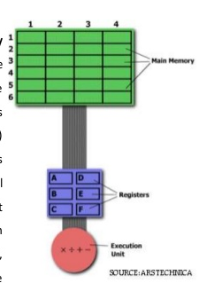
Example
You have some data in RAM
You have some registers to store data to and from RAM
You have your execution unit (ALU)
You have some numbers in memory
You want to take two numbers from memory
Multiply them together
For example we will say Row 6 Column 1 has the number 5 and Row 2 Column 4 has the number 8

Slide 6
Example
So we want Row 6:Column 1 * Row 2:Column 4 and put the answer back in Row 6: Column 1
8
5

Slide 7
RISC
RISC = Reduced Instruction Set Computers
In RISC. We have a reduced set of instructions.
It means we can only do one thing (one instruction) per cycle
Our Control Unit can only handle one thing at a time.
So it means our instructions must be simple.
8
5

Slide 8
RISC
Our multiplication example needs the following in RISC:
LOAD A, 6:1 (This loads data (5) from RAM into a register)
LOAD B, 2:4 (Loads data (8) from RAM into another register)
PROD A, B Multiplies the two numbers
STORE 6:1, A Stores the value we got into Row 6, Column 1
8
5

Slide 9
RISC
LOAD A, 6:1 LOAD B, 2:4
PROD A, B STORE 6:1, A
So we can see we have one thing on one line because our control unit uses RISC which means it can only do one instruction per cycle.
The thing it can do per cycle is simple and you must remember that in a single second a CPU can have millions of cycles.
Also RISC has to LOAD data from memory into register
8
5

Slide 10
CISC
Complex Instruction Set Computers
Uses microcode to have micro programmed implementation
Microcode = small amounts of code (Not as small as RISC)
Micro programmed implementation = when your control unit uses Microcode
Human example:
RISC
Breathe in
Send air to lungs
Do something here
Breathe out
CISC
Breathe
The command breathe in CISC is microcode. It implies that if you say ”breathe” then the breathe in, send air to lungs, do something and breathe out are built in.

Slide 11
CISC
Uses micro programmed design
Has a lot more instructions than RISC
More complex instructions then RISC
Similar to HLL
Less lines of code required
So for the same task we only need
MULT 6:1, 2:4
This also loads the two numbers into two separate registers. Multiplies the numbers. Stores the numbers in the register…but all using the ‘complex’ instruction MULT
CISC works directly with the RAM. You (programmer) don’t have to worry about loading or storing from the RAM, CISC will handle that for you
8
5

Slide 12
RISC | CISC
Simple instructions | Complex instructions
One instruction = one cycle | Many instructions = One cycle
Register to Register (LOAD and STORE are separate commands) | Memory to Memory (LOAD and STORE are built into the instructions)
Speeds up individual instructions | Tries to do a task in few lines as possible
Instructions are fixed length | Variable length instructions
Fewer addressing modes | More addressing modes
Multiple register sets | Fewer registers
Hard wired control unit | Microprogrammed control unit
Easier pipelining | Harder pipeline

Slide 13
Addressing modes
How you calculate the memory address.
Absolute / Direct The address number you give is the address where the data is
PC – Relative The next instruction + an offset = memory address
Register indirect If you say look in register B14, then it looks in B14 and now B14 takes control
Sequential The next instruction is next in memory
Conditional Has a fixed +1 offset. Similar to an IF statement. IF register B14 = 0 then SKIP
And there are many more

Slide 14
So what is faster?
Debateable
More but simpler instructions versus Less but complex instructions
Time per program = time per cycle * cycles per instruction * instructions per program
RISC wants to minimise cycles per instruction
CISC wants to minimise instructions per program

Slide 15
Pipelining
Because in RISC each instruction has a fixed length.
And each instruction is one cycle
It is easier to pipeline tasks
Pipeline = Instruction level parallelism
Instruction level parallelism = breaking one task down into different stages

Slide 16
Unpipelined
Where one instruction must finish before another one can start
No parallelism. Only one instruction being done at a time.
Jobs
Time

Slide 17
Pipelined
Where one instruction is broken down into different stages
Once task A finishes on the first on the first job then task B begins, at the same time, while task B is running on the first job, task A is starting work on the second job
A
B
C
Jobs
A
B
C
A
B
C
A
B
C
Time

Slide 18
Pipelined
Each task (A, B and C) run on a different circuit
The total amount of time from the start of task A to task C for a single job may be the same as unpipelined. Its just that you are starting to work on a different job while another job is still running.
In this example we split into 3 stages so our parallelism is 3
Jobs
A
B
C
A
B
C
A
B
C
A
B
C
Time

Slide 19
Quick task
What is the throughput of the following:
You can assume that each stage represents 24 hours and one job = 24 hours
A
B
C
Jobs
Jobs
A
B
C
A
B
C
A
B
C
Time
Time

Slide 20
Throughput
The maximum rate of which something can be processed
In example 1. Our throughput is 24 hours. One job = 24hrs We cannot process anything else until one job is done.
In example 2 our throughput is 8 hours. When one stage is is done we can work on another and each stage is only 8 hours
A
B
C
Jobs
Jobs
A
B
C
A
B
C
A
B
C
Time
Time

Slide 21
Cycle and Clock
We have been using the word job.
At the start of each Job is actually the start of a cycle
So Stage A is really the start of another cycle
A
B
C
Jobs
A
B
C
A
B
C
A
B
C
Time

Slide 22
RISC
We said RISC is easier for pipeline because we can segment the instructions easier as they are fixed length.
But what are the stages we break up a RISC job into?
There are 5 stages:
1. Instruction Fetch : Get the instruction (IF)
2. Instruction decode : Understand the instruction (ID)
3. Operand Fetch : Get the operand (OF) (Example 5 + 8. 5 and 8 are the operands, + is the operation)
4. Instruction Execute : Do the instruction (IE)
5. Write Back : Return the result of the IE (WB)

Slide 23
Pipelining
Here we see an example from your course book
1.1 = Instruction 1. Stage 1 (IF)
1.2 = Instruction 1. Stage 2 (ID)
2.1 = Instruction 2. Stage 1 (IF)
You will notice the top reads clock cycle.
We can also work out clock speed too.

Slide 24
Clock speed
We said each block is 24 hours. That’s way too long for a CPU so lets say each instruction / job / cycle takes 3 nano seconds.
In unpipelined we say 1 instruction takes 3 nano seconds = 333MHz
Its actually 1 spike every 3 nano seconds but we get to spikes on the next slide.
Jobs
Time

Slide 25
Clock speed
The total length of time for each instruction to be filly finished is still 3ns.
But clock speed is how fast each cycle is spiking. The spiking happens when one job ends and another starts. This happens every 1ns (because each stage takes only 1 ns)
So we have our clock speed = number of clock spikes by time.
We have 1 spike every 1 ns = 1 GHz
A
B
C
Jobs
A
B
C
A
B
C
A
B
C
Time

Slide 26
Interrupts
Say you are doing a job. You pipelined it into 5 stages.
But now you need to interrupt it for something more important. What happens? Now you are disturbing 5 different stages.
There are two main ways interrupts are handles.
1:
Erase the pipeline of the last 4 stages and then the interrupt process will happen on the remaining instruction.
But this means you lose whatever was in your pipeline
2: Use individual registers to handle the interrupt with the processor. This lets you keep your existing pipeline

Slide 27
Today
8. SISD, SIMD, MISD, MIMD
9. Give examples of the role of virtual machines
10. Understand the benefits and limitations of virtual machines
Understand: What are the types of parallel processing
Able: Demonstrate a virtual machine
Answer: What are the advantages and disadvantages of a VM

Slide 28
Parallel Processing
Record a physical example of the following
One video per example
You may need to use props such as paper balls to do so:
Pick a number 1– 5
1. SISD and SIMD (and supercomputers vs clusters computing)
2. SIMD and MISD (and supercomputers vs clusters computing)
3. MISD and MIMD (and supercomputers vs clusters computing)
4. MIMD, SISD and SIMD (and supercomputing)
5. MIMD, SISD, SIMD and MISD (and cluster computing)
SISD = Single instruction Single Data Stream
SIMD = Single instruction Multiple Data Stream
MISD = Multiple instruction Single Data Stream
MIMD = Multiple instruction Multiple Data Stream

Slide 29
Parallel Processing
There are 4 basic computing architectures (this word ‘architecture is annoying because its used for Von Neumann also)
SISD = Single instruction Single Data Stream
SIMD = Single instruction Multiple Data Stream
MISD = Multiple instruction Single Data Stream
MIMD = Multiple instruction Multiple Data Stream

Slide 30
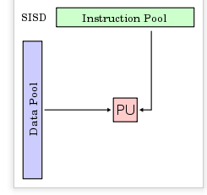
SISD = Single instruction Single Data Stream
SISD: Single Instruction and Single Data Stream(SISD)
One Processing Unit
One Control Unit
One Memory Unit
One instruction pool
One data pool
One CPU does one instruction at a time
Instructions are done in order of arrival (sequential)
Instruction pool = the list of instructions that can be used
Data pool = Your data source
PU = Processing Unit / CPU

Slide 31
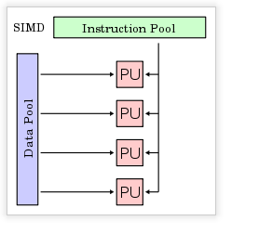
SIMD = Single instruction Multiple Data Stream
Multiple Processing Units
One Control Unit
One Memory Unit
One instruction pool
One data pool
The control unit sends the SAME instruction to all processing units.
But each processing unit does a SAME operation on a different parts of the instruction

Slide 32
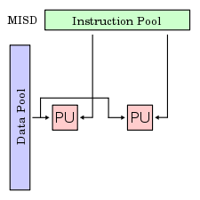
MISD = Multiple instruction Single Data Stream
Multiple Processing Units
One Control Unit
One Memory Unit
One instruction pool
One data pool
In SIMD it was one instruction, but that instruction was being worked on at the same time by different processing units.
In MISD, you have one instruction, but that instruction is being worked on at the same time by different processing units. BUT the difference is with SIMD, those processing units are doing the same thing, in MISD those processing units can be doing different things with the data.

Slide 33
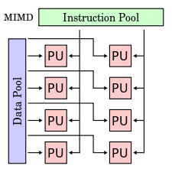
MIMD = Multiple instruction Multiple Data Stream
Multiple Processing Units
One Control Unit
One Memory Unit
One instruction pool
One data pool
Multiple processing units working with multiple pieces of data doing different things with the data at the same time.

Slide 34
Virtual Machines
If your computer architecture can allow for it, then you can run two OS at the same time.
Now I do not mean that your computer can run another OS, like BootCamp for MacOS – this is just running one OS at a time.
A virtual machine (VM) is when you run two OS’s at the same time.
It actually doesn’t even have to be two different OS, VM’s with the same OS are popular for testing
Why?

Slide 35
Virtual Machines + & -
+Run different OS / programs without needing another computer
+Secure area to test new software, if something messes up then only your VM gets messed up
Takes up your machines hard drive, processor, memory and resources
Slower than using a dedicated machine

Slide 36
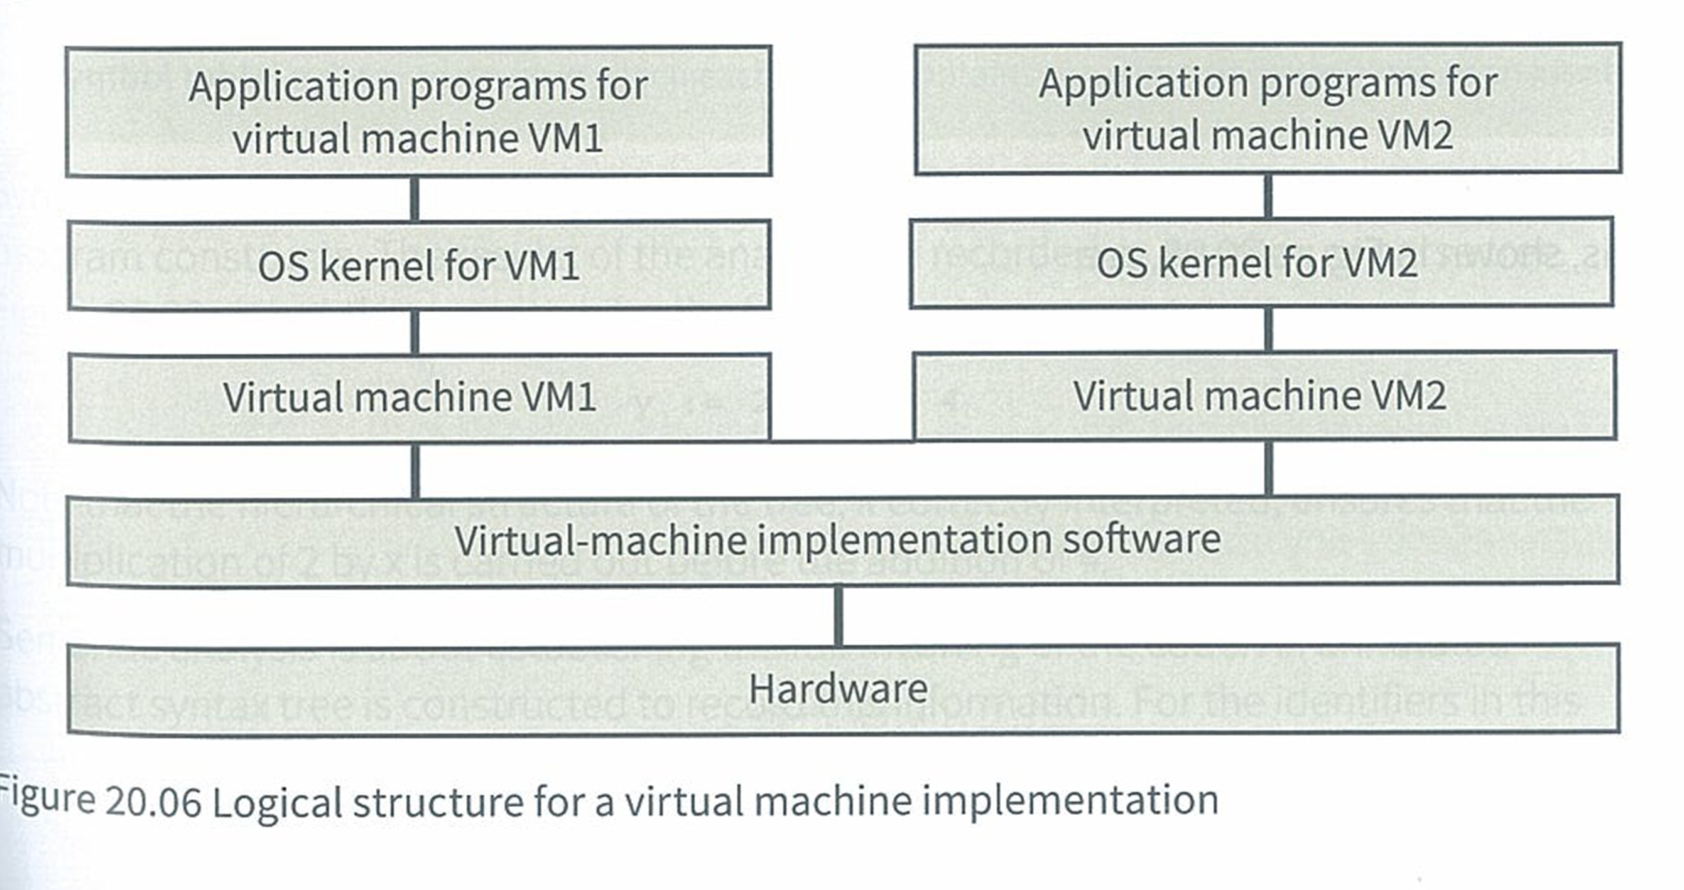
Virtual Machines
One machine, one computer, two operating systems.
Must have compatible hardware.
The kernel for the virtual machine handles talking to the hardware.
+ Can run two OSs on one machine
+ Run specific programs (Run windows programs on Mac)
+ Run older software on newer hardware
Time and effort to implement
Performance is worse then if it was a standalone machine

Slide 37
Virtual Machine structure

